Slide 1
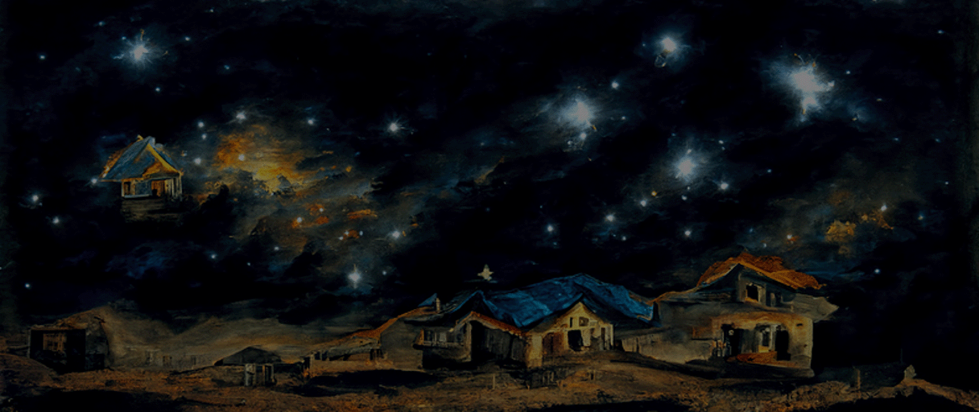


Energy Use in Households
How people in the UK use energy at home in 2020 and 2021?
- Group 11 -

Slide 2

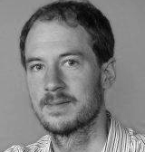


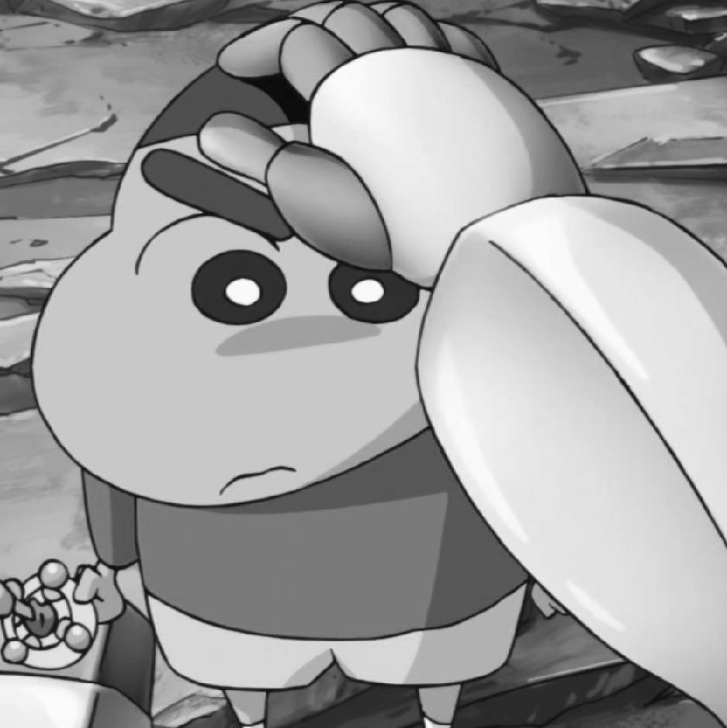


Overview Project Team
University of Edinburgh
Advisor
Dr. Benjamin Bach
Dr. Martin Pullinger
Zonglin Ji
Supervisor
Data Owner
Tutor
University of Edinburgh
Core Team
Xinyuan Feng
Kaihuang Huang
Runyan Gan
Liuyang Chen
Project Team
Project Team
Project Team
Project Team
Research Findings | December, 2022
1

Slide 3
1. Intro
2. Application
3. Findings
4. Next Steps

Slide 4
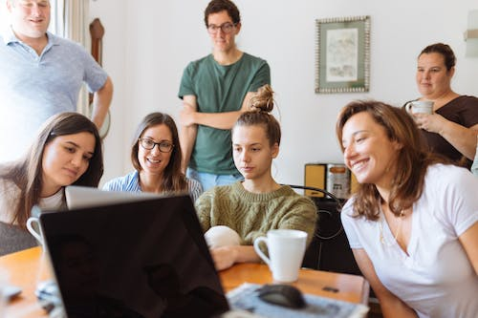

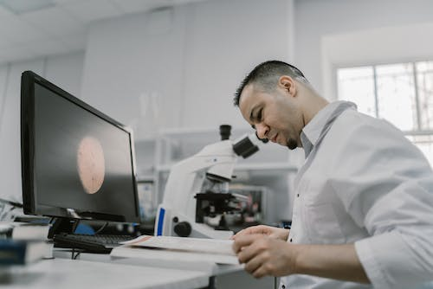
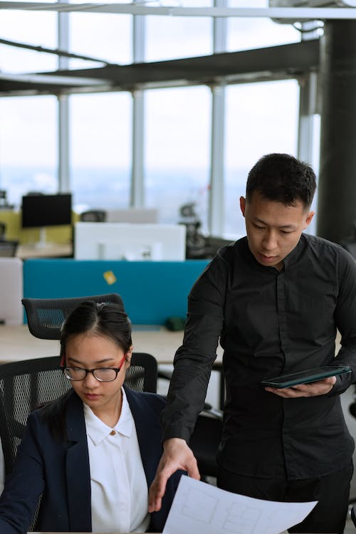
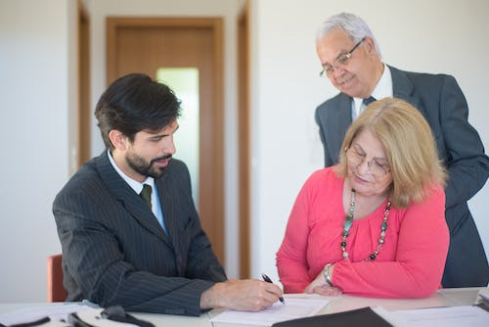
We hypothesize that our potential audience could be divided into 4 types.
User
Type 4
Common
Users
User
Type 2
Researchers
User
Type 3
Energy
Suppliers
User
Type 4
Government
Officers
Interested at the energy consumption information
Conduct research on the energy consumption habits
Want to use it as a reference for deciding the energy price and storage
Want to find documents as a reference for the policy
Research Findings | December, 2022
2

Slide 5
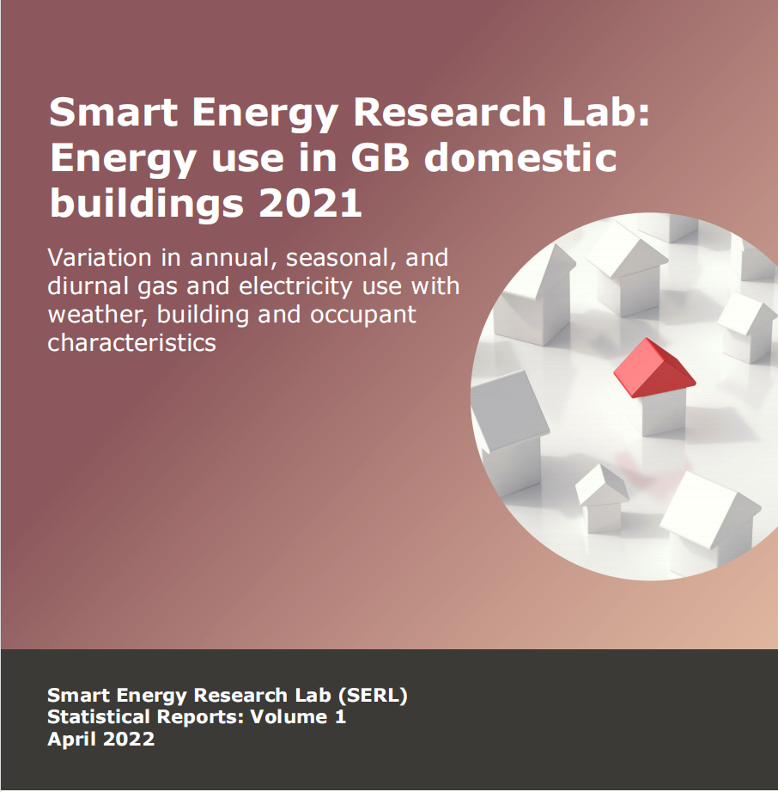
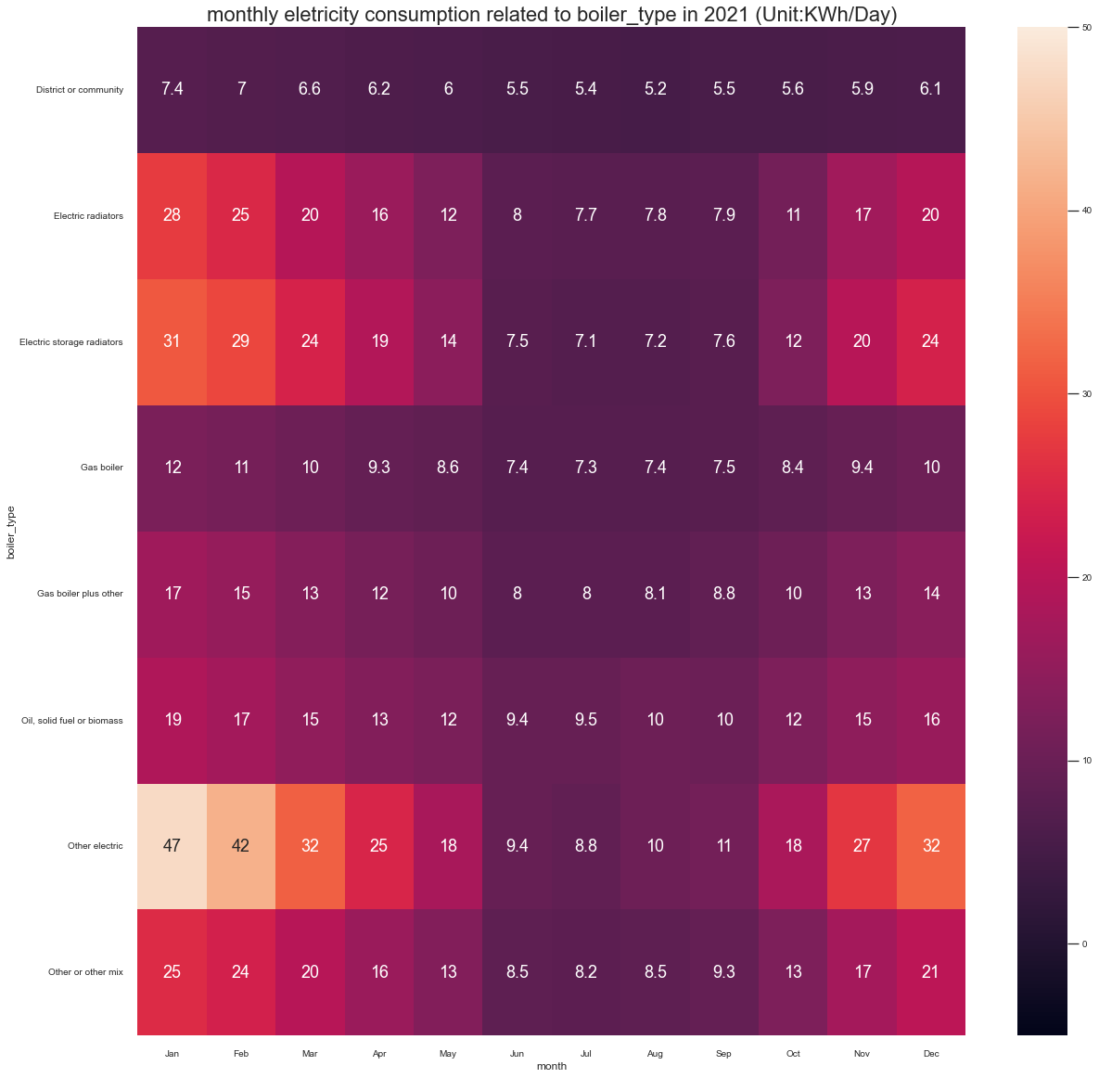
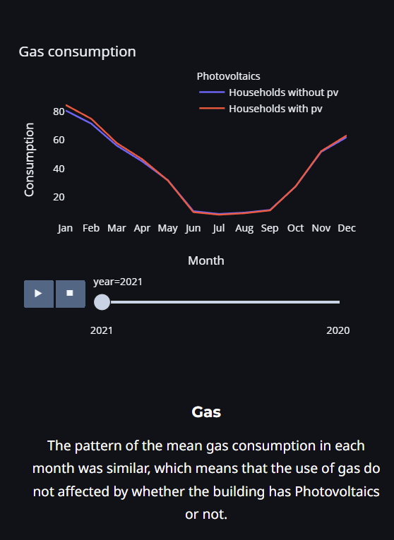
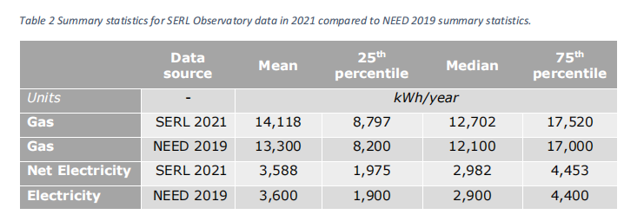
Our Project Goal is to satify potential users’ needs, improve the visualization of the original report and dig deeply on some data.
Improve the visualization
&
Dig Deeply on Data
Previous
Basic
Report
Research Findings | December, 2022
3

Slide 6



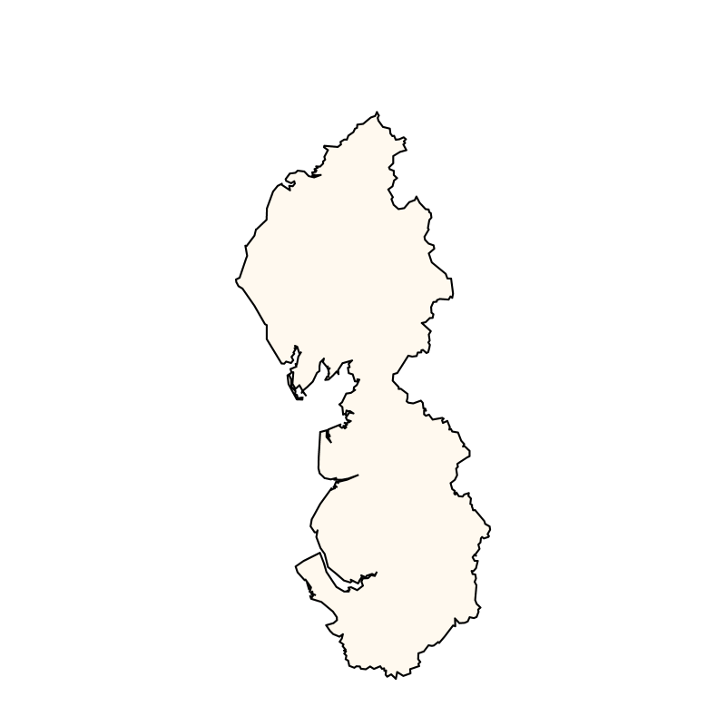
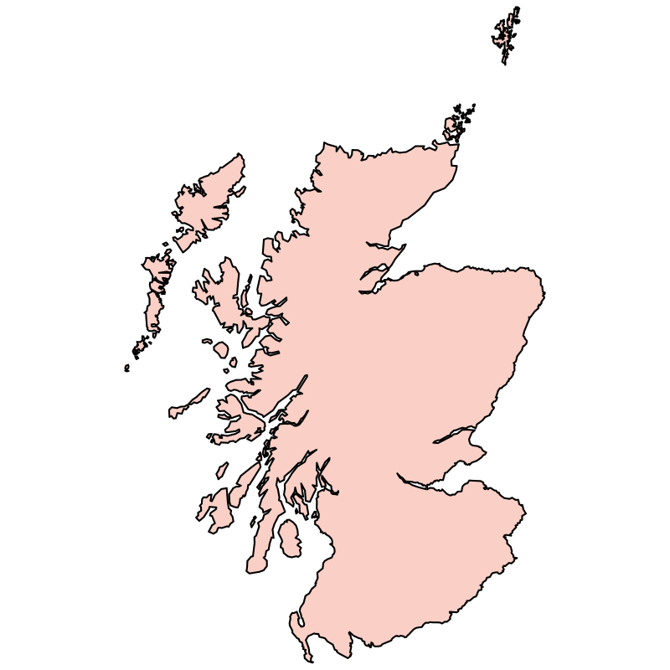
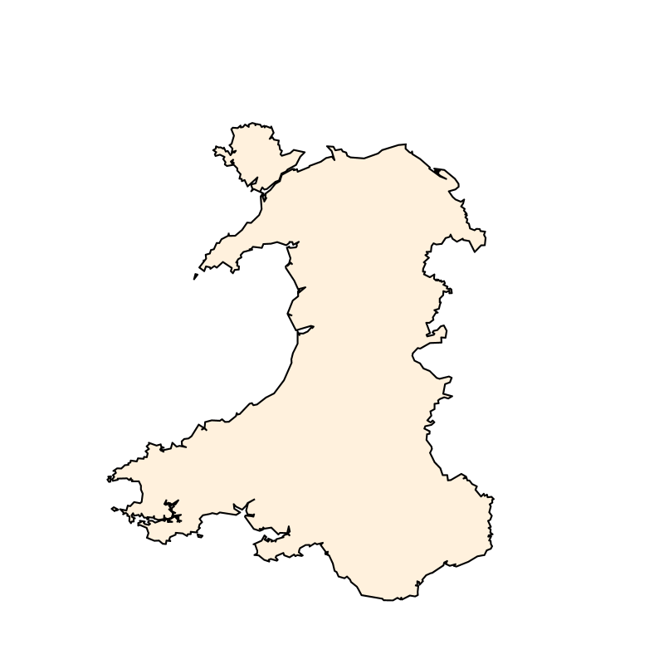
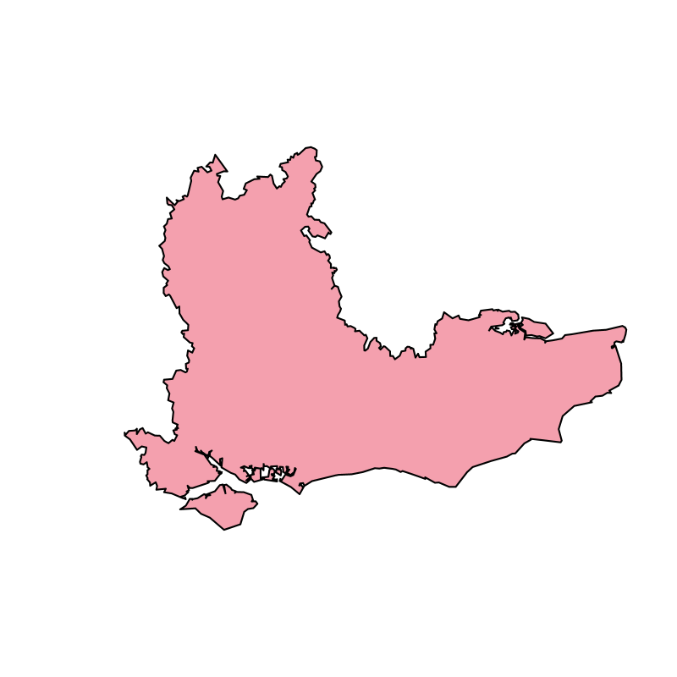
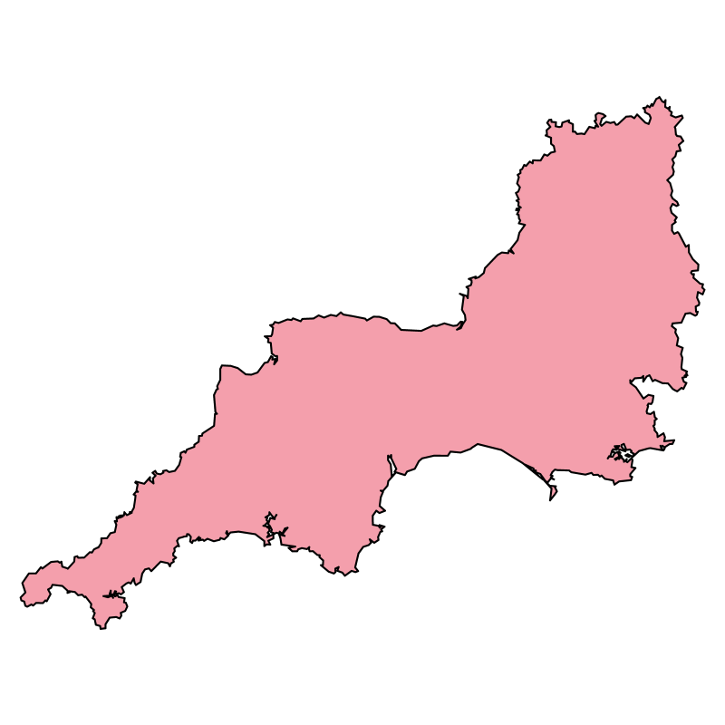



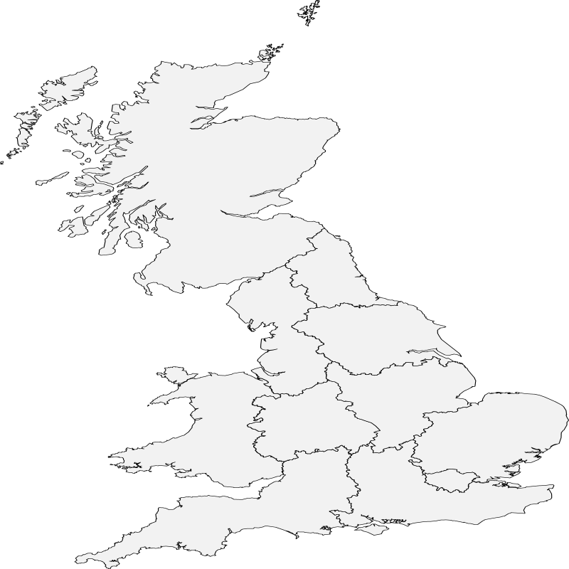

Data Brief
1,042 East of England
1,047 Greater London
455 North East
1054 Yorkshire
13,000
Britain Participants
1450 North West
1161 Scotland
1555 South East
847 East Midlands
1068 South West
701 Wales
1047 West Midlands
1021 Unclear
Research Findings | December, 2022
4

Slide 7

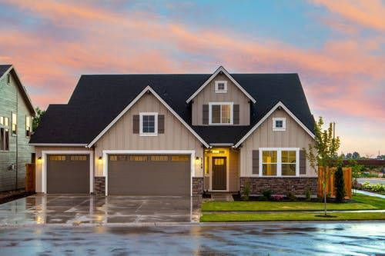

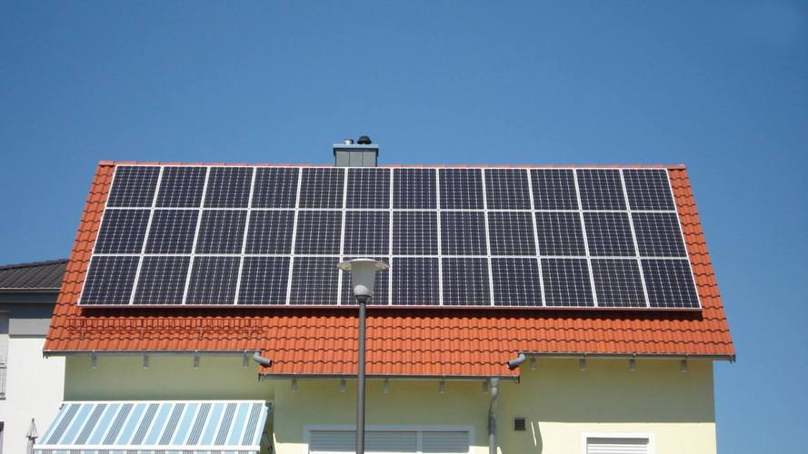


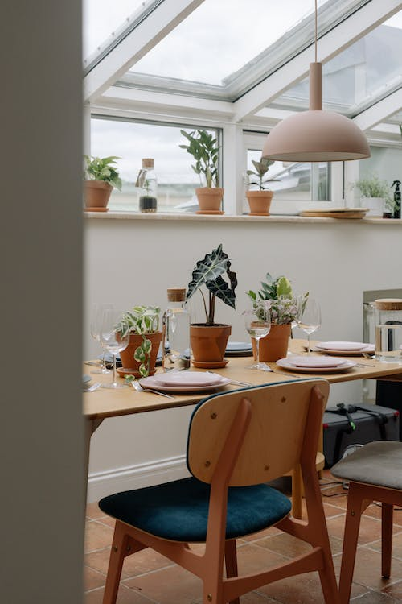
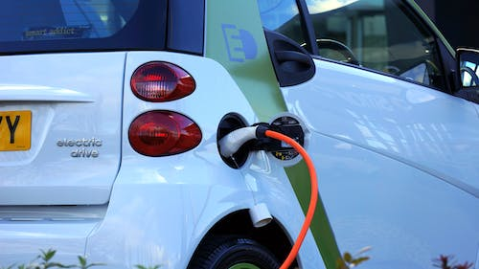
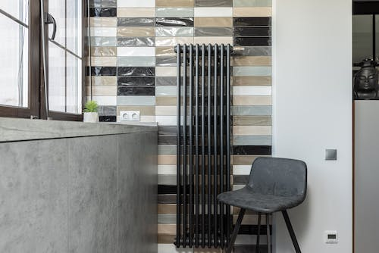

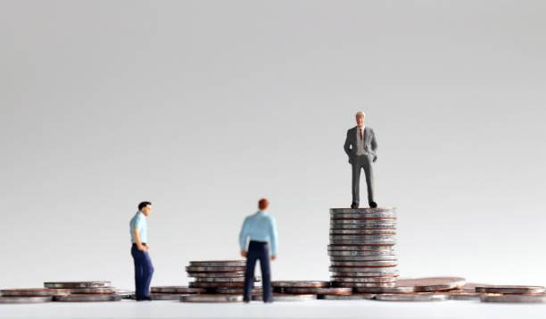
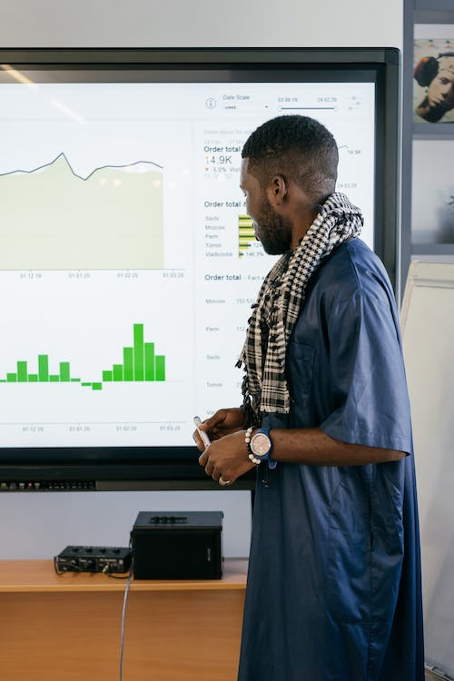


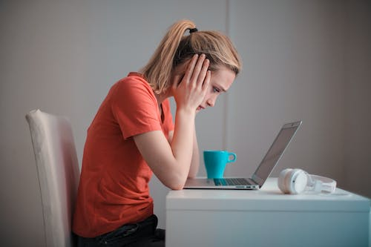
Data Brief
External Temperature
Building Types
Number of Occupants
Has Photovoltaic
Tenure Types
15
Segmentation Variables
Boiler Type for Electricity Consumption
Boiler Type for Gas Consumption
Number of Bedrooms
Floor Area
Has EV
IMD Quintile
Current Energy Rating
Weekday or Weekend
Region
Building Age
Research Findings | December, 2022
5

Slide 8

Data Brief
External Temperature
Building Types
Number of Occupants
Has Photovoltaic
Tenure Types
15
Segmentation Variables
Boiler Type for Electricity Consumption
Boiler Type for Gas Consumption
Number of Bedrooms
Floor Area
Has EV
IMD Quintile
Current Energy Rating
Weekday or Weekend
Region
Building Age
Research Findings | December, 2022
5

Slide 9
1. Intro
2. Application
3. Findings
4. Next Steps

Slide 10



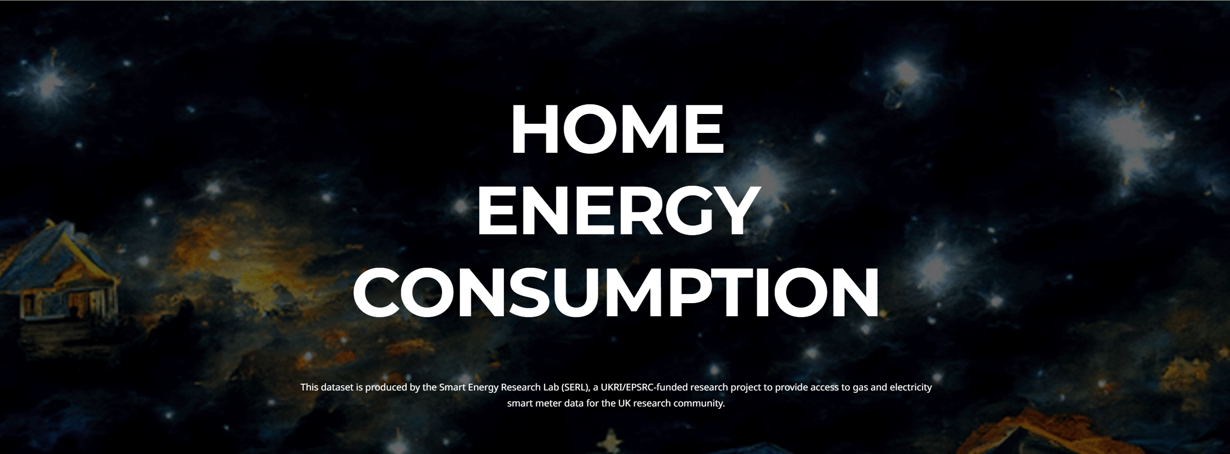
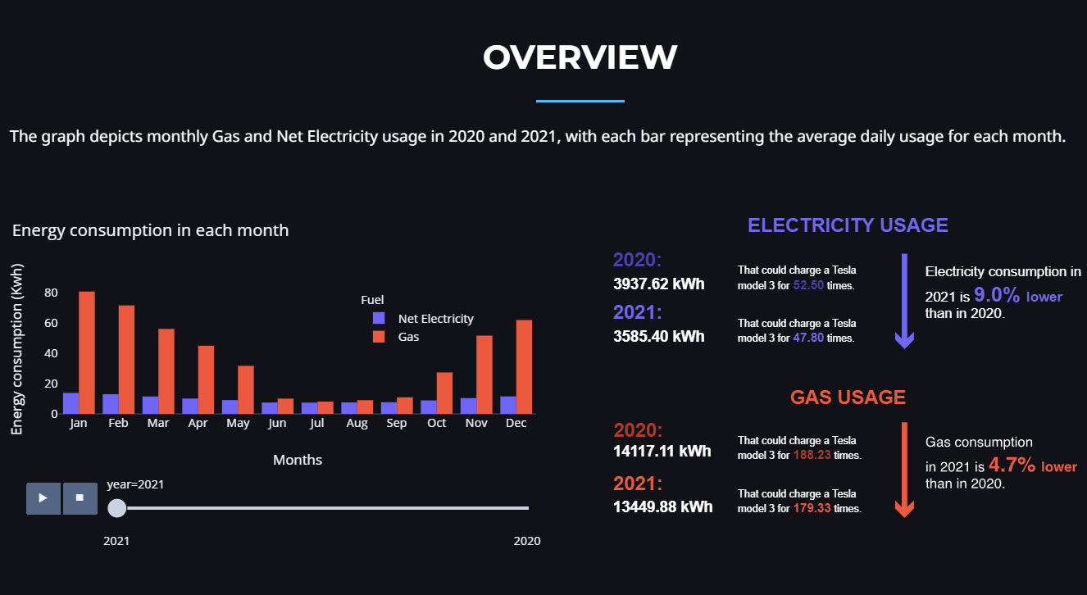
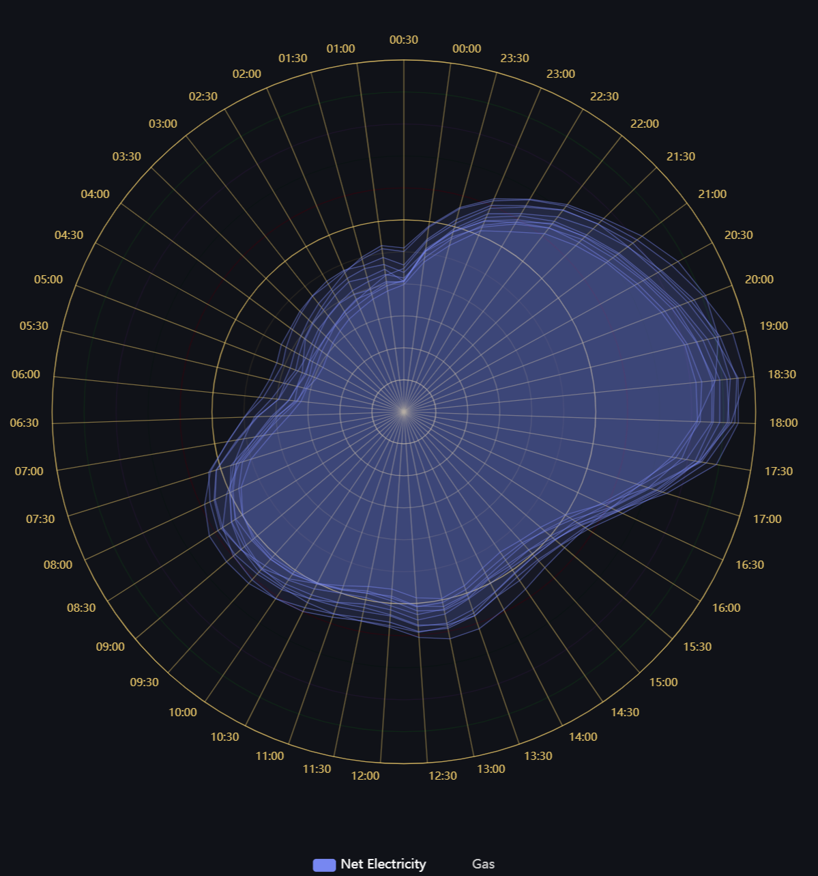
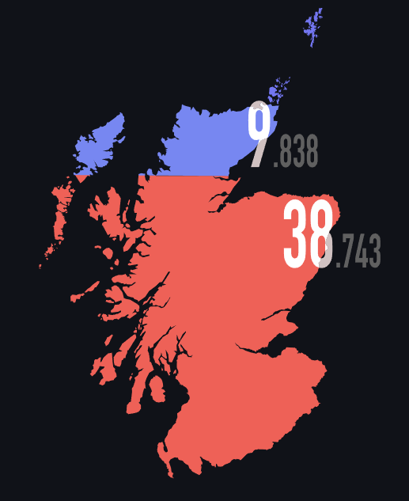
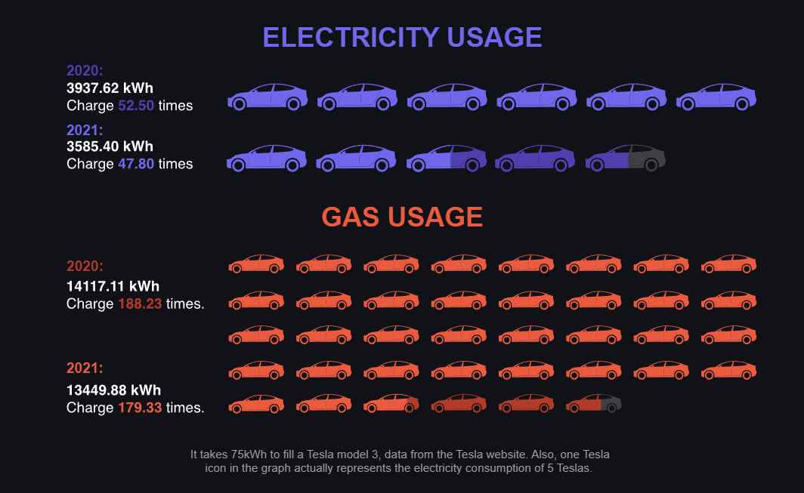
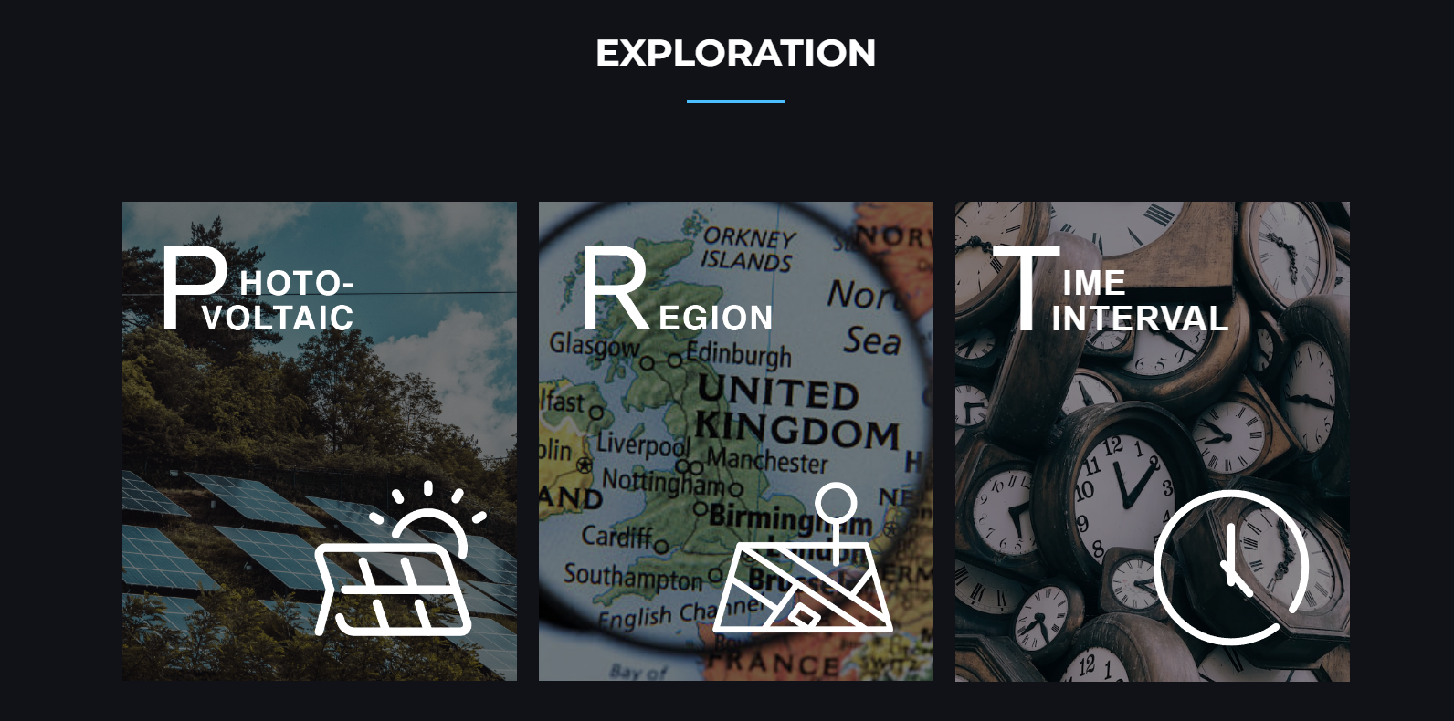
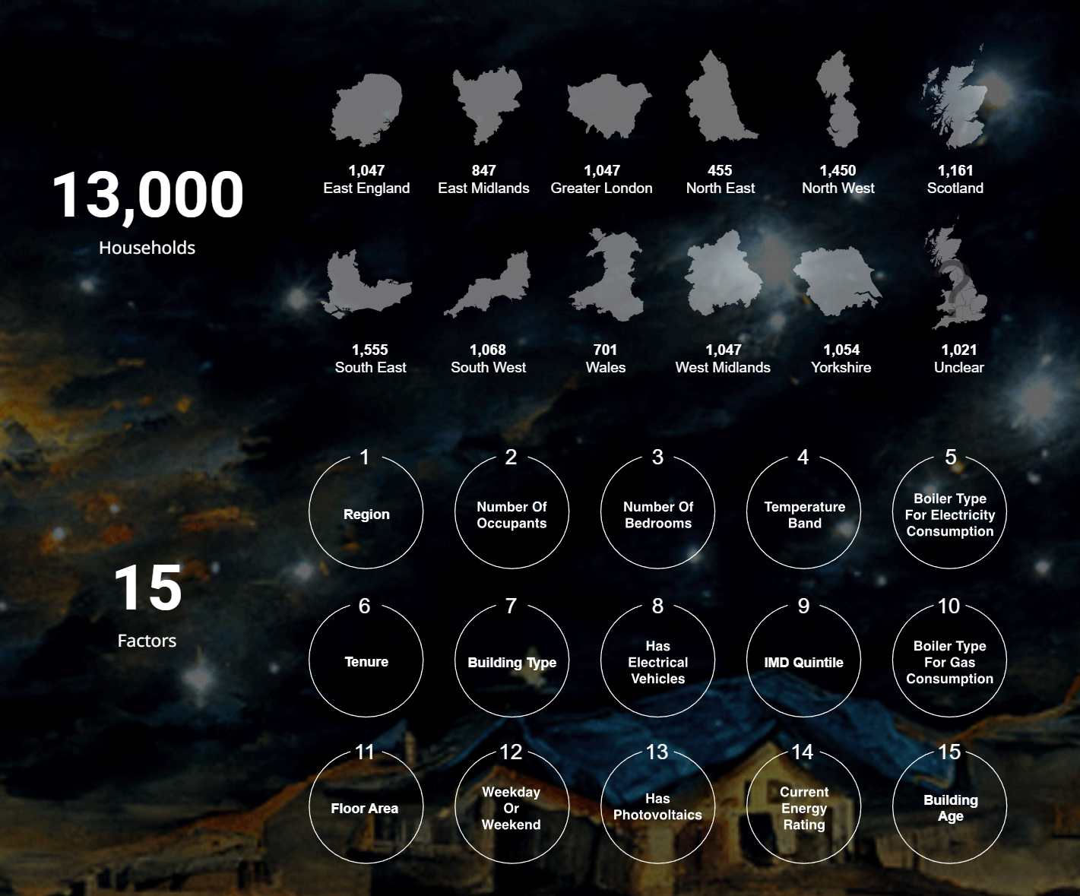
We built a website for potential users
Based on data owner’s expectations and users’ convenience, we decided to use a website to negotiate with users.
Brief introduction of the data set
Overview of the energy consumption in 2020 and 2021
Exploration of 3 interesting questions about the impact of PV, Region and Time Intervial
1.
2.
3.
Website: HOME ENERGY CONSUMPTION
Research Findings | December, 2022
6

Slide 11
1. Intro
2. Application
3. Findings
4. Next Steps

Slide 12
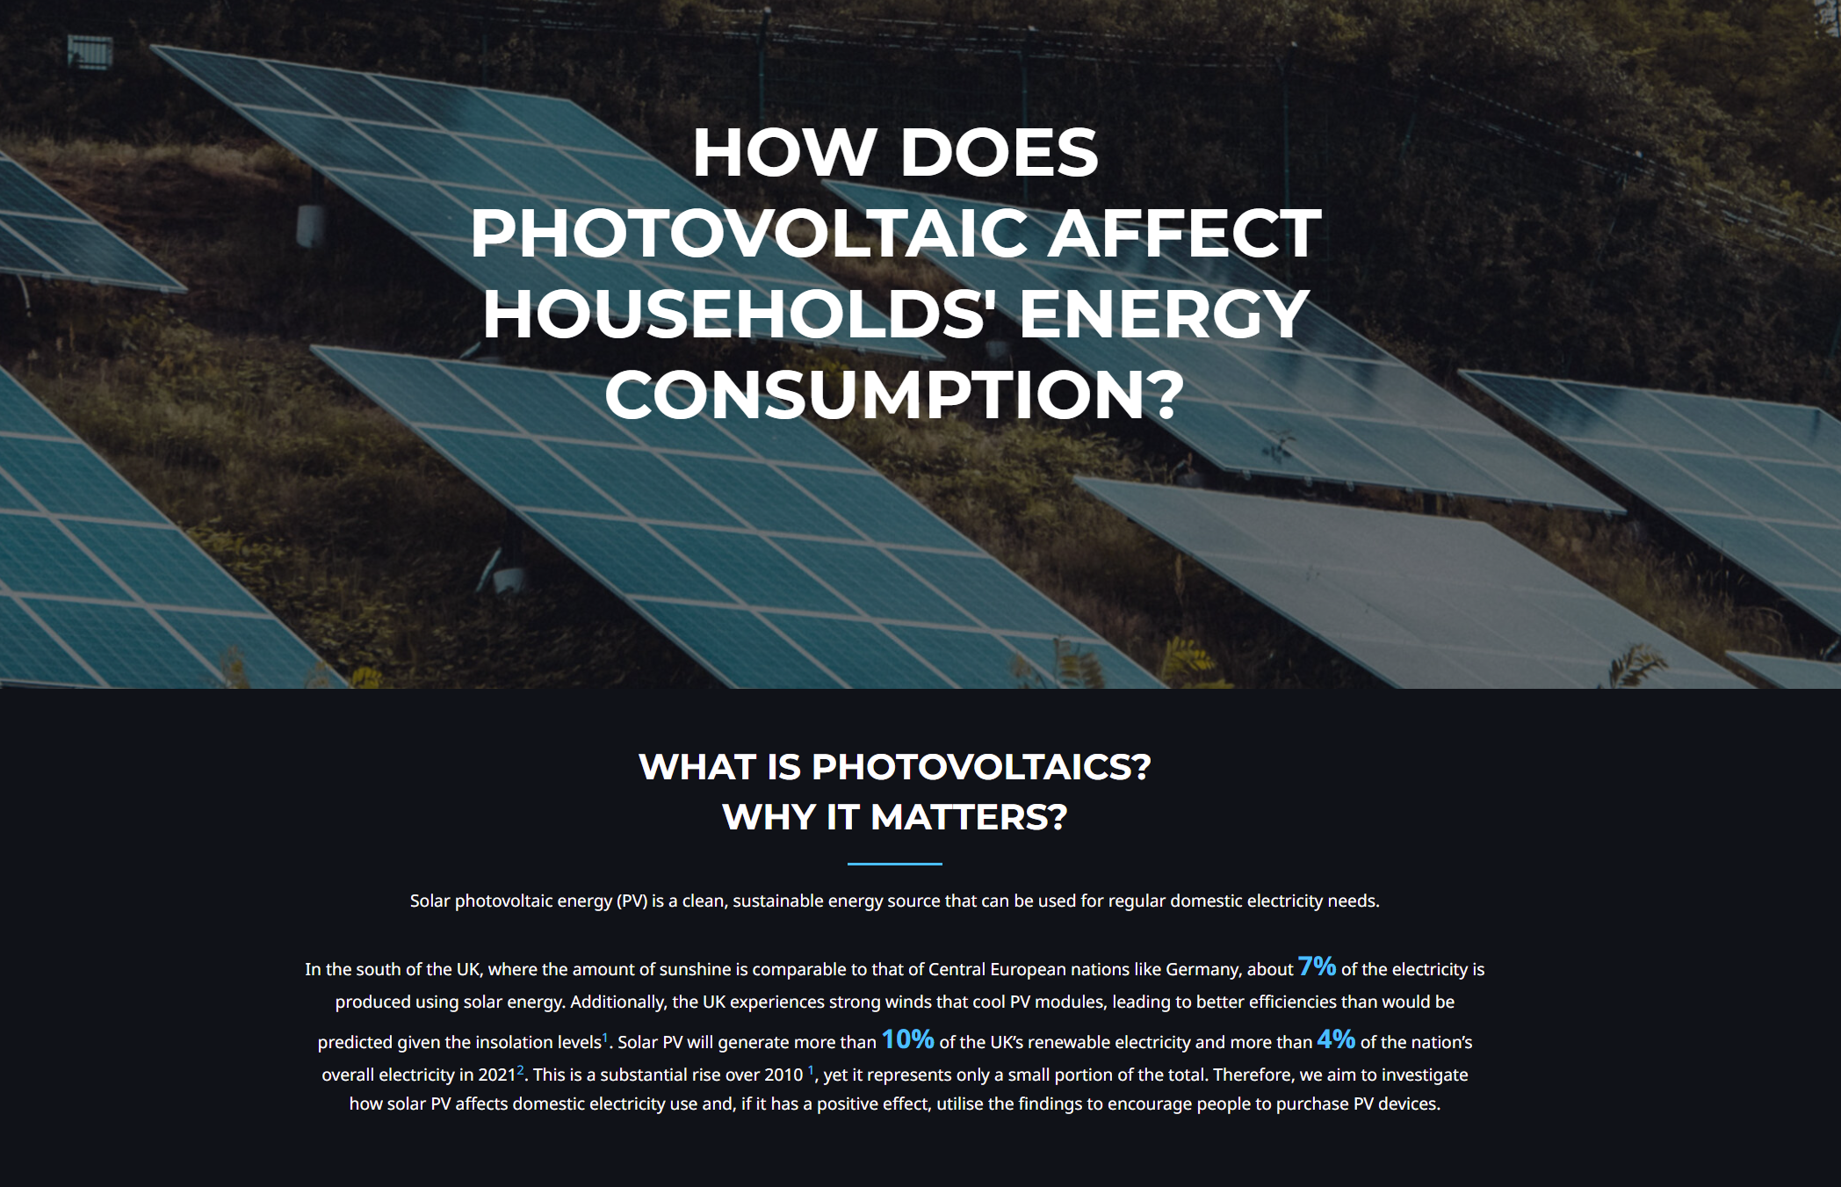
x
e.g. How photovoltaic devices affect households’ energy consumption?
Website: HOME ENERGY CONSUMPTION
we have found that photovoltaic devices have strong impact on household’s energy consumption
Findings
Findings
Research Findings | December, 2022
7

Slide 13
1. Intro
2. Application
3. Findings
4. Next Steps

Slide 14
As for next step, we would like to refine the data analysis findings, maintain our website and try one more interesting visualisation method.
Trial
Maintain the website
Refine the data analysis findings
Research Findings | December, 2022
8

Slide 15

# Thanks for Watching
Question & Feedback
DS4D Group11
UoE | Design Informatics
E-Mail: s2315477@ed.ac.uk

Slide 16
There is no obligation to create a slideshow for your presentation, however, I think it will be easeist. We would like the following to be covered in the presentation:
- data, audience, tasks/messages (your goal) ---- very briefly! 1-2 sentences.
- important findings ---- 1 slide max.
- your project for A3 ---- most of the presentation. Demo us your idea and where you are at the moment.
- any specific questions / things you are still working on and would like feedback from. Take this presentation to get feedback on your progress and to ask the audience questions where you have a hard time making decisions. We are all here to help each other and give contructive feedback.
- practice your 5min presentation. We will cut you off after 5min. This is common practice everywhere.
Let me know any questions by email, cc'ing your tutors so they can respond, too.

Slide 17
Brief
Create a piece that communicates about the data you have, including developing the context and exploring implications. This assignment is carried out as a group project, with a grade per group against three learning outcomes (Data, Program, Communicate). This is an open brief, which means you can take whatever approach is appropriate and use whatever techniques are available to your group to understand your data and communicate your findings. Previous submissions have included reports, interactive websites, physicalisations, information videos, data comics and more. You will have a chance to present this in Week 11 (3rd of December) shortly before handing in. Any medium is permissible, subject to space/time/technical/resource constraints, for example:
interactives, websites, data comics, infographics, AR/VR, physicalisations, dance/theatre work
etc.
AND
Submission: This is a Group submission - only one person from each group needs to submit. You should submit:
Slides from your presentation
AND
A 500 word PDF explaining the main rationales behind your design choice, e.g., the context and findings, your audience. Explain why you have chosen a specific format or story, etc.
Unpacking Learning Outcomes
Your work relates to the learning outcomes in a similar way to Assignment 1:
LO1: Data - show that you are aware of issues surrounding the data - social context, problems that may exist, bias, underrepresentation, missing data and so on. Demonstrate that you are handling and processing data correctly.
LO2: Program - carry out an appropriate computational processing of the data using relevant computational tools.
LO3: Communicate - Communicate your findings. This is a combination of how well your artefact communicates to a target audience and how well your presentation communicates your process and findings.

